Slide 1
3.1: Introduction to state-space models

Slide 2
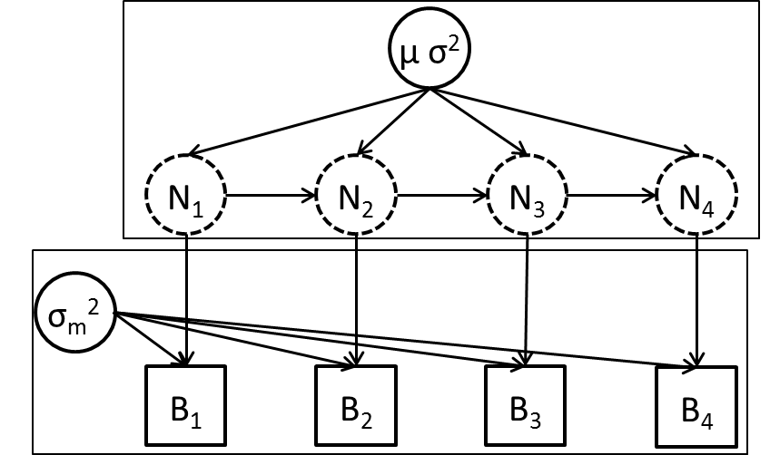
Say we’re sampling changes in fish abundance over time
“Time series” of samples for same site
“Open population” (has births, deaths, migrations)
Measurement + Process errors
“State-space model”

Slide 3
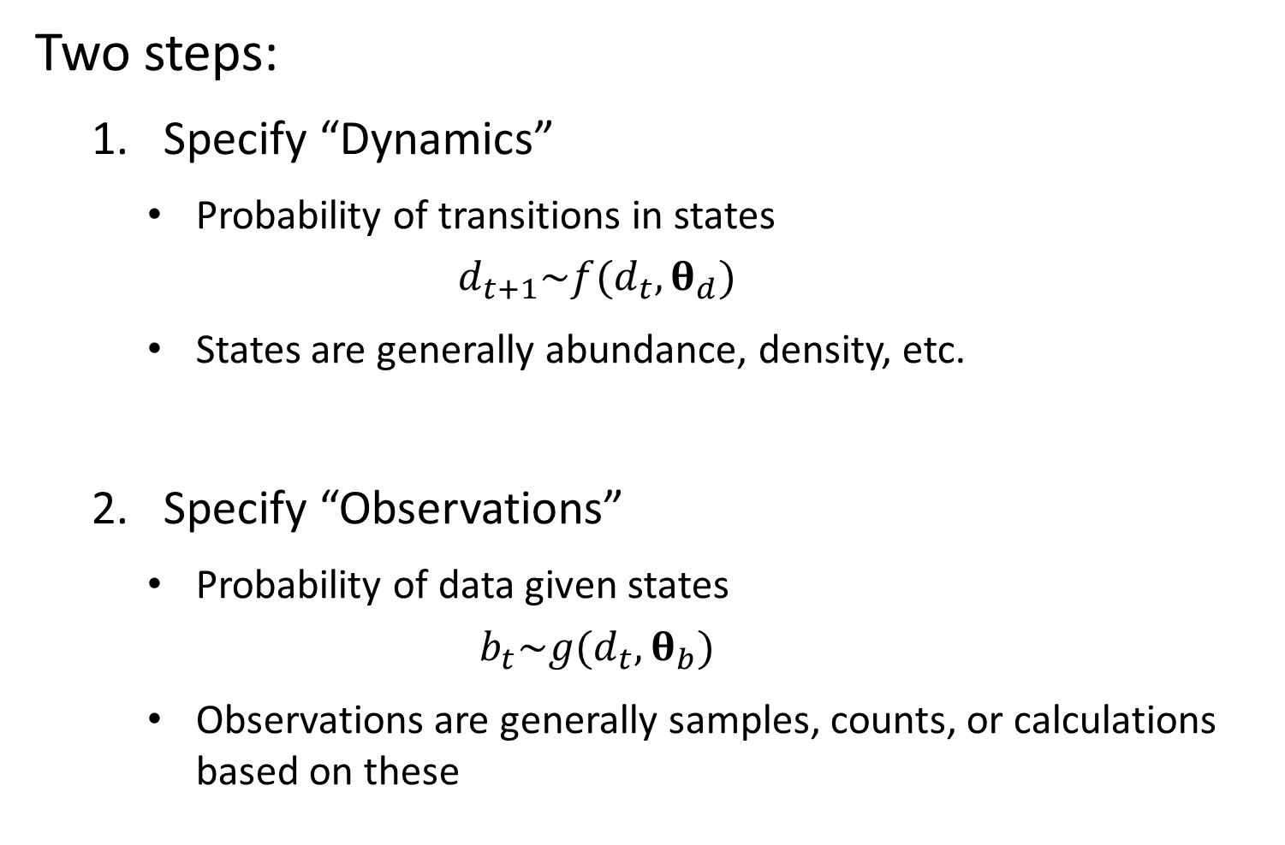
Two steps:
Specify “Dynamics”
Probability of transitions in states
$$d_{t+1}\sim f(d_{t},θ_{d})$$
States are generally abundance, density, etc.
Specify “Observations”
Probability of data given states
$$b_{t}\sim g(d_{t},θ_{b})$$
Observations are generally samples, counts, or calculations based on these

Slide 4
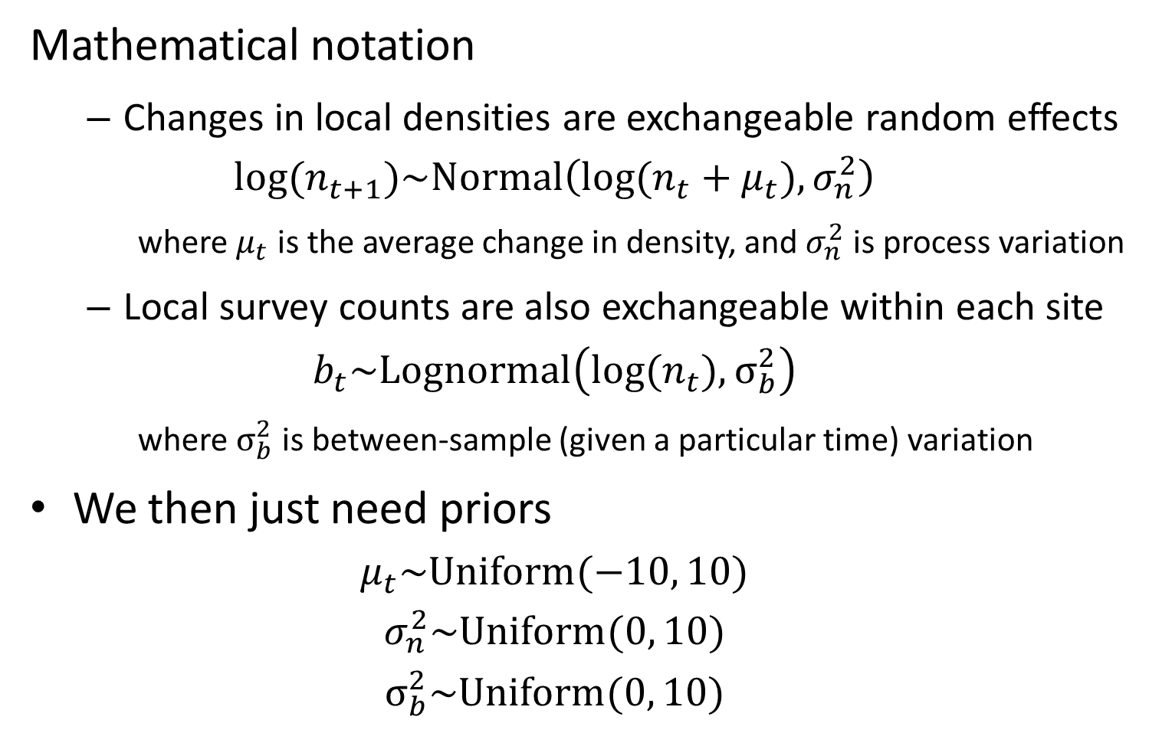
Mathematical notation
Changes in local densities are exchangeable random effects
$$log⁡(n_{t+1})\sim Normal\left(log⁡(n_{t}+μ_{t}),σ_{n}^{2}\right)$$
where $μ_{t}$ is the average change in density, and $σ_{n}^{2}$ is process variation
Local survey counts are also exchangeable within each site
$$b_{t}\sim Lognormal\left(log⁡(n_{t}),σ_{b}^{2}\right)$$
where $σ_{b}^{2}$ is between-sample (given a particular time) variation
We then just need priors
$$μ_{t}\sim Uniform(−10, 10)$$
$$σ_{n}^{2}\sim Uniform(0, 10)$$
$$σ_{b}^{2}\sim Uniform(0, 10)$$

Slide 5
State-space model example
[See R code]

